Slide 1
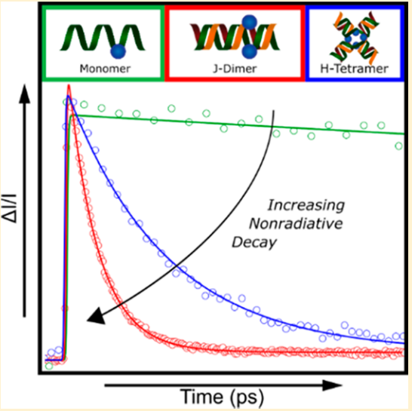
Excited-State Dynamics in DNA-Templated Molecular Dye Aggregates
Jonathan S. Huff†, Daniel B. Turner†, Olga A. Mass†, Matthew S. Barclay †, Bernard Yurke†§, William B. Knowlton†§, Paul H. Davis†, and Ryan D. Pensack*†
†Micron School of Materials Science & Engineering, §Department of Electrical & Computer Engineering, Boise State University, Boise, Idaho 83725, United States (*e-mail: ryanpensack@boisestate.edu (R.D.P))
1. Motivation
3. Results and Discussion A
4. Results and discussion B
Dye aggregates are assemblies of optically active molecules that support collective excited states known as molecular excitons.
Quantification of excited-state lifetimes
Origin of heterogeneity
The molecular excitons formed supported by dye aggregates exhibit interesting properties that make them suitable for a variety of potential applications including light harvesting,¹ sensing,² and photothermal therapy.³
(a)
(b)
(c)
(d)
By measuring the denaturation temperatures of each solution, we determined that the Holliday junction templates adopt stacked configurations (see Fig. 3)
Comparing iso I and II for each structure in Fig 3 we note:
In the transverse dimer, which exhibits little aggregate heterogeneity, dye-dye interactions may stabilize the iso I form.
In the adjacent dimer, the dyes are more distantly spaced than the transverse dimer, so weaker dye-dye interactions may result in heterogeneity.
The trimer solution is the most heterogeneous and the iso configurations are the most obviously different.
The tetramer dye configurations for each isomer are identical according to the model, which is consistent with the lack of observed heterogeneity.
A promising strategy to achieve fine control over dye aggregation is to covalently attach dye molecules to DNA strands that self-assemble into configurations that bring dyes into close proximity and facilitate aggregation.
This strategy of DNA templating enables the study of dimers and higher order aggregates with sub-nm scale control of dye placement.^{4,5}
Figure 3. Cartoon depictions of the two stacked Holliday junction isomers. The relative placement of the dyes (shown as orange dots) may inform the observed heterogeneity in the solutions.
In a recent study, ⁶ we investigated the excited-state dynamics of a dimer and tetramer of the Cyanine dye, Cy5, templated on a DNA duplex and mobile Holliday junction (HJ), respectively. The Cy5 aggregates exhibited dramatically reduced excited-state lifetimes due to enhanced nonradiative decay.
Figure 2. Selected TA spectra for (a) the transverse dimer (b) the adjacent dimer (c) the trimer, and (d) the tetramer. For each plot, the absorption and TA pump spectrum are plotted on the same wavelength axis above the TA spectra.
Developing a means to control aggregate excited-state lifetimes is critical to realizing many applications of DNA templated dye aggregates.
We used femtosecond transient absorption spectroscopy (TA) to measure the excited state dynamics of the DNA-templated Cy5 aggregate solutions.
All solutions exhibited complicated multiexponential relaxation kinetics.
We determined through TA measurements that the adjacent dimer and trimer solutions exhibit substantial heterogeneity (i.e., multiple aggregate subpopulations), while the transverse dimer and tetramer solutions exhibit a lesser degree of heterogeneity.
We used global target analysis (GTA) to extract the lifetimes of the aggregate populations (See table 1).
Recent studies have largely observed reduced excited-state lifetimes in DNA templated aggregates of cyanine dyes.
Key Knowledge gap:
Can enhanced nonradiative decay in DNA-templated dye aggregates be mitigated with an appropriately chosen DNA template?
2. DNA Templated Dye Aggregate Design
5. Conclusion
Here,⁷ we investigated the excited-state dynamics of a set of Cy5 aggregates templated on immobile HJs⁸ rather than duplexes and mobile Holliday junctions.
We prepared solutions of two distinct Cy5 dimers (adjacent and transverse), a trimer, and a tetramer covalently tethered to immobile HJ DNA templates self-assembled in solution following the procedure of Cannon et al.⁹
In conclusion, we studied the excited state dynamics of several Cy5 dye aggregates assembled on immobile DNA Holliday junctions. Using femtosecond TA, we measured excited-state lifetimes significantly shorter than that of the Cy5 monomer for all of the solutions studied. The lifetimes varied over a considerable range from tens to hundreds of ps. The reduced lifetimes result from enhancement of nonradiative decay upon aggregation. Additionally, we used TA and GTA to confirm the presence of aggregate subpopulations in each solution, which we attributed largely to the presence distinct stacked Holliday junction isomers giving rise to distinct dye packing configurations. The range of excited state lifetimes and heterogeneity suggest that both of these parameters may be optimized through modification of the DNA template.
Table 1. Time constants associated with the excited state lifetimes for each DNA-templated Cy5 aggregate solution. 𝜏₁ corresponds to the lifetime primary aggregate population while 𝜏₂ corresponds to the secondary population, if applicable.
Structure | 𝜏₁(ps) | 𝜏₂(ps)
Monomer | 1300 | --
Transverse Dimer | 202 | --
Adjacent Dimer | 40 | 242
Trimer | 30 | 80
Tetramer | 40 | --
Cy5
Holliday Junction DNA Template
Adjacent
Dimer
Transverse
Dimer
6. References & Acknowledgments
References
[1]T. Brixner et al., Adv. Energy Mater. 2017, 1700236, 1–33.; [2]E. Arunkumar et al., J. Am. Chem. Soc. 2005, 127 (9), 3156.; [3]W. Hu et al., ACS Nano 2019, 13 (10), 12006.; [4]H. Asanuma et al., J. Photochem. Photobiol. C Photochem. Rev. 2012, 13 (2), 124.; [5]L. I. Markova et al., Chem. Commun. 2013, 49 (46), 5298.; [6] J. S. Huff et al., J. Phys. Chem. Lett. 2019, 10 (10), 2386.; [7] J.S. Huff et al., In preparation.; [8]N. Seeman et al. Biophys. J. 1983, 44 (2), 201.; [9] B.L. Cannon et al., J. Phys. Chem. A 2018, 122 (8), 2086.;
Trimer
Tetramer
Compared to the Cy5 monomer, all aggregate populations exhibit greatly reduced excited-state lifetimes, which we determined to be the result of an increase in the nonradiative decay rate.
The range of excited-state lifetimes (40-242 ps) is broader than was previously observed for duplexes and mobile HJs,⁶ and may be related to the separation between the dyes comprising an aggregate.
Acknowledgments
Research at Boise State University was supported by the National Science Foundation (NSF) through the Integrated NSF Support Promoting Interdisciplinary Research and Education (INSPIRE) via award No. 1648655. Specific equipment was supported by Department of Energy, Idaho National Laboratory, Laboratory Directed Research and Development project through blanket master contract No. 154754 between Battelle Energy Alliance and Boise State University, Release 15. Specific equipment was also supported by the U.S. Department of Energy, Office of Basic Energy Sciences, Division of Materials Science and Engineering through the Established Program to Stimulate Competitive Research (EPSCoR) award No. DE-SC0020089, and the Department of the Navy, Office of Naval Research (ONR) under ONR award No. N00014-19-1-2615.
Figure 1. (Left) The chemical structure of the cyanine dye, Cy5, functionalized with two linkers for insertion into the DNA backbone. (Middle) DNA sequence and schematic structure of the immobile HJ template used in this study. The sites labeled with “[x]” correspond to dye attachment sites. (Right) Cartoon depictions of the adjacent dimer (red), transverse dimer (pink), trimer (blue), and tetramer (green) aggregates studied.

